Slide 1
trashcore post processing in unity 2021 and URP 12 featuring Jpeg and Nihilism™️ image compression

Slide 2
Change your perspective

Slide 3
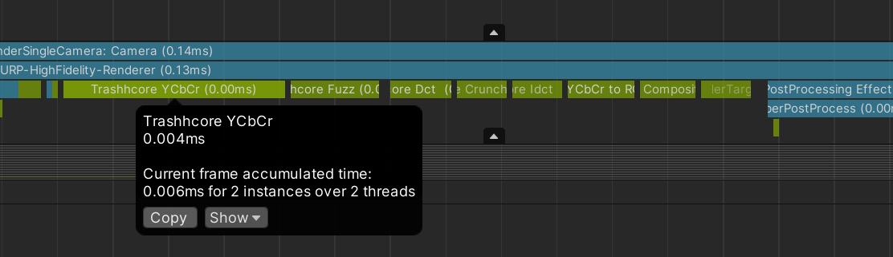

Slide 4
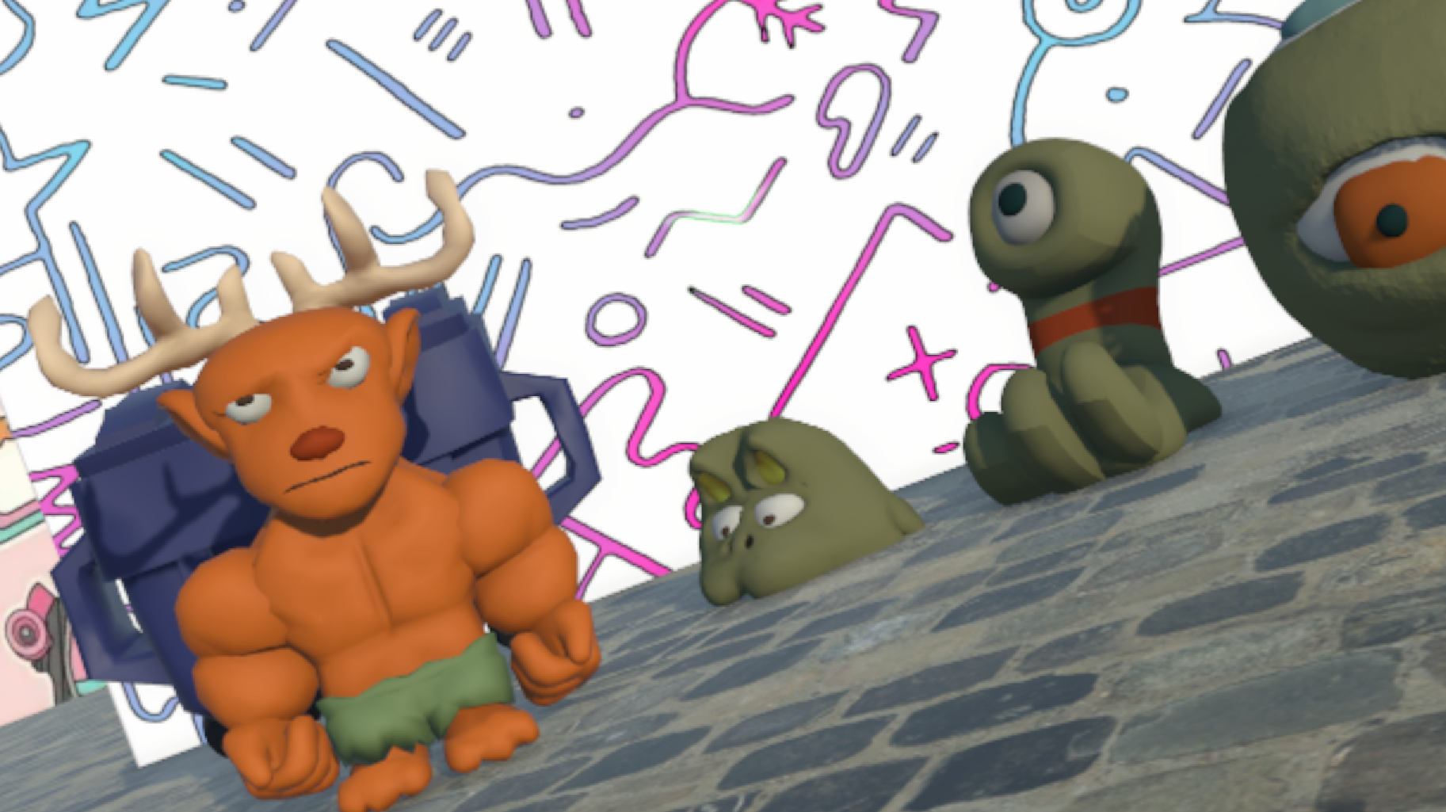
Original frame

Slide 5
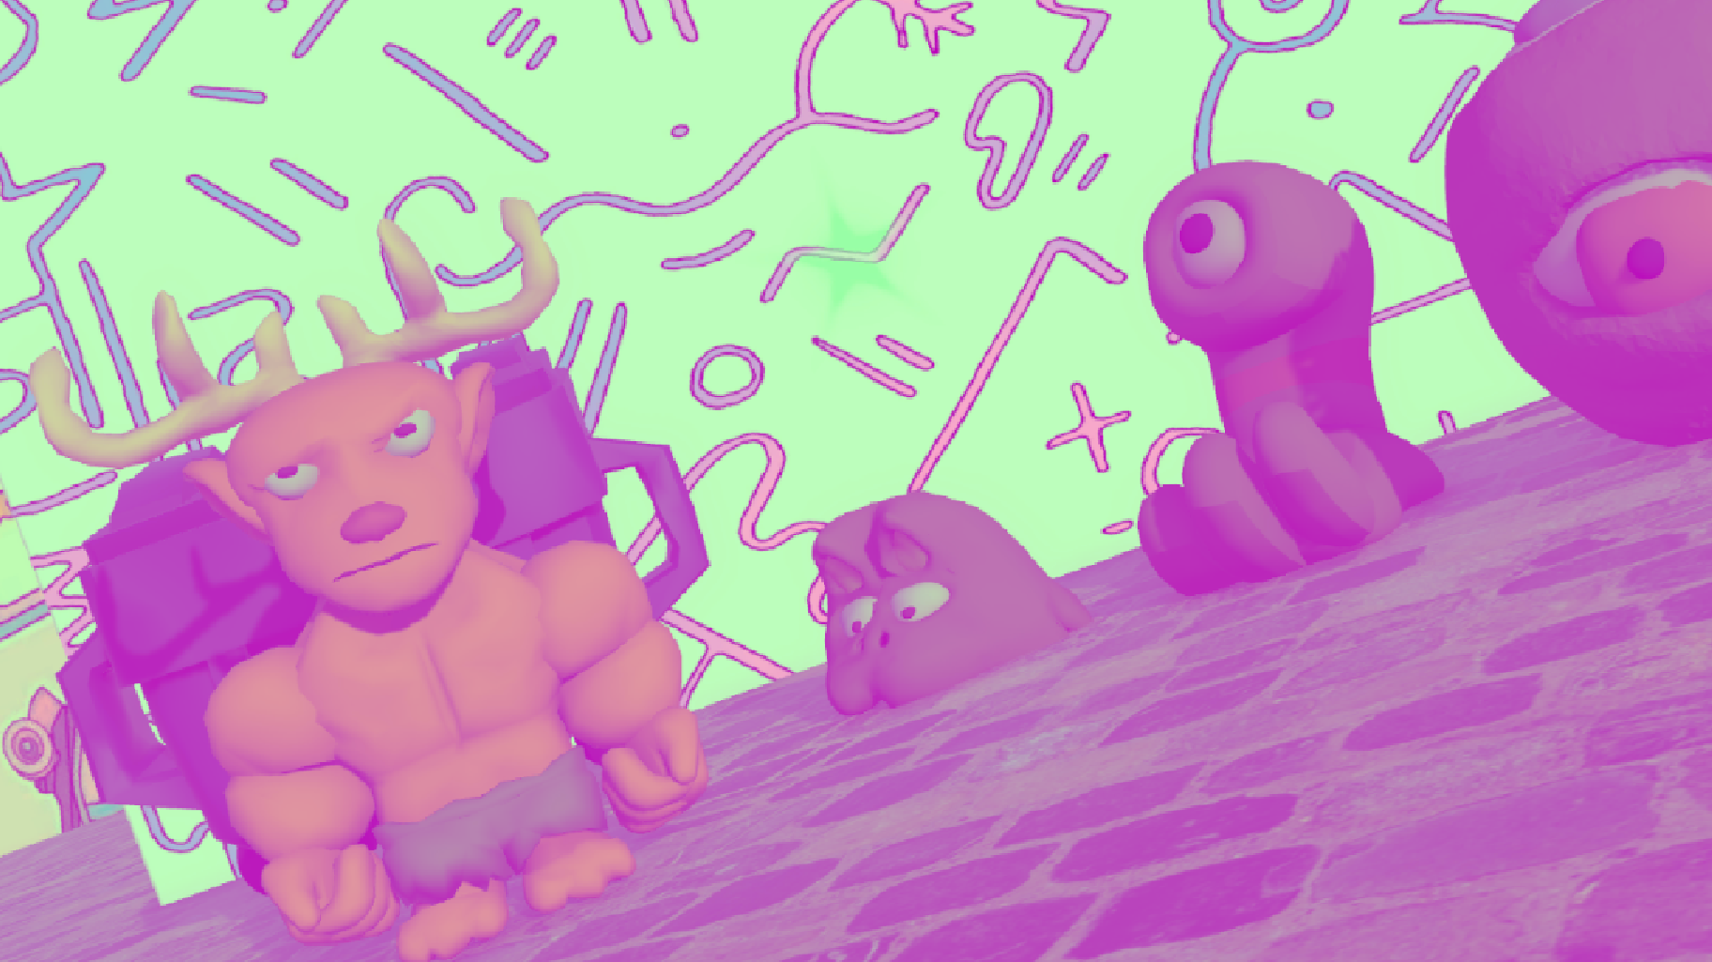
Convert to Y Cb Cr

Slide 6
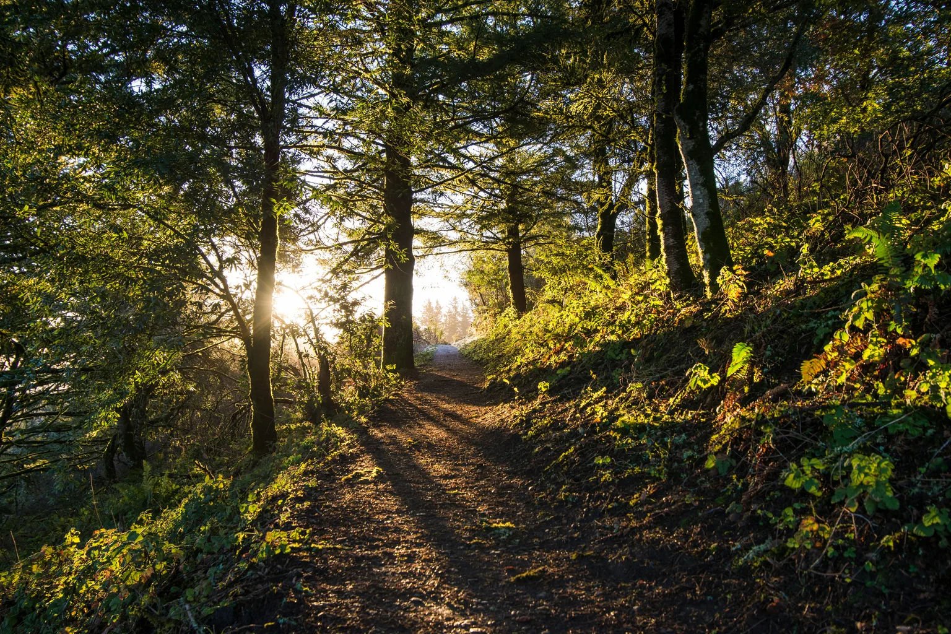
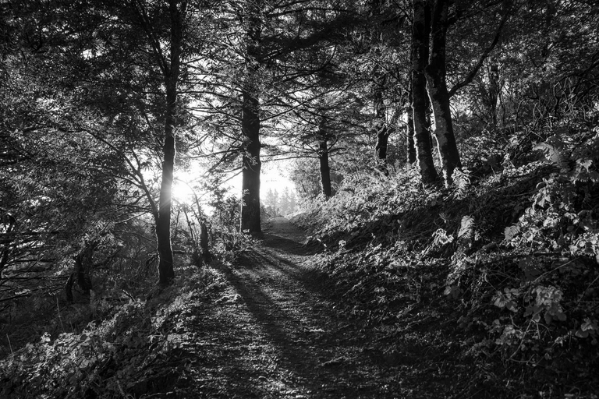
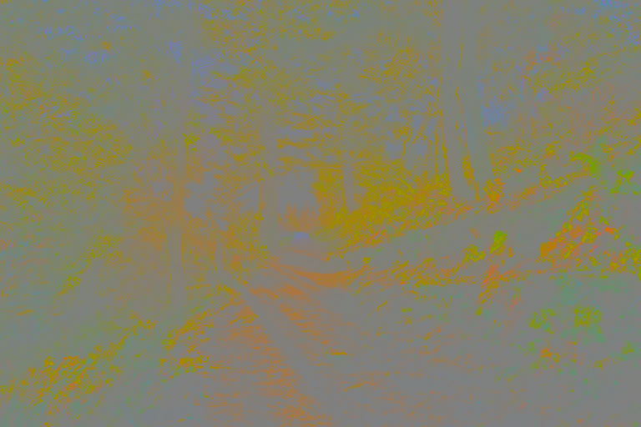
Original
(rgb)
Y
(luma)
CbCr
(chroma)

Slide 7
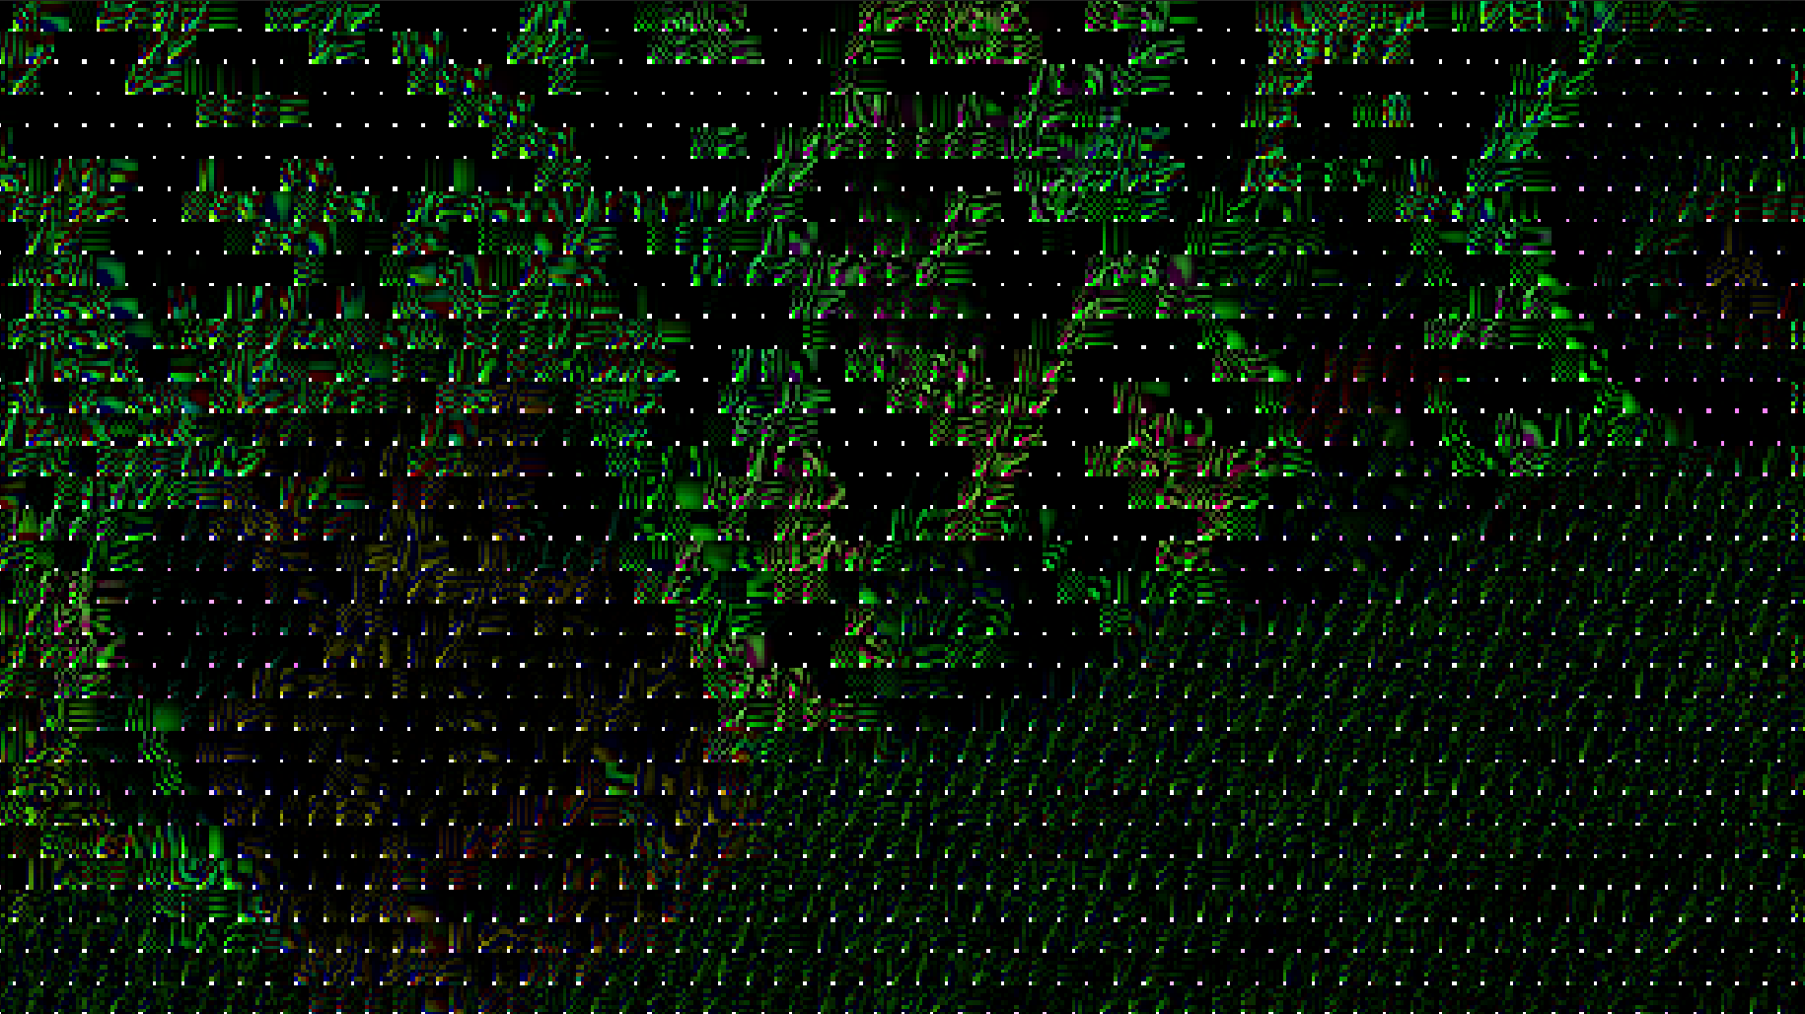
Discrete Cosine Transform

Slide 8
Crunch

Slide 9
Inverse Discrete Cos Transform

